Slide 1

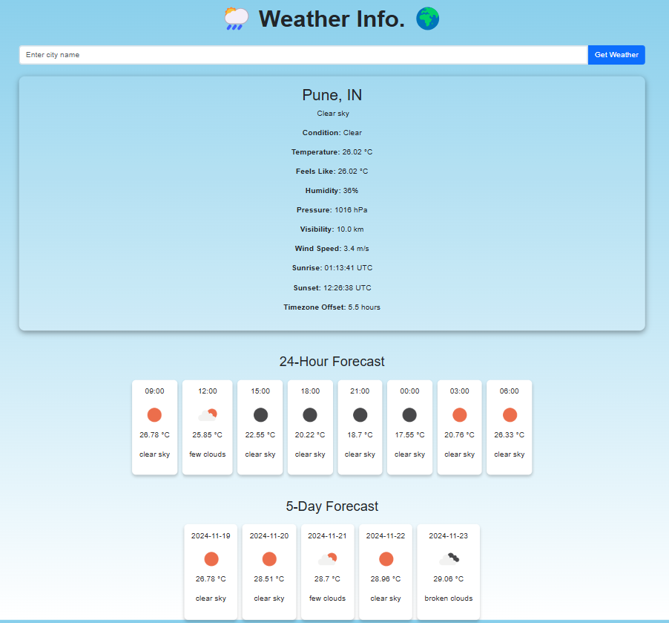
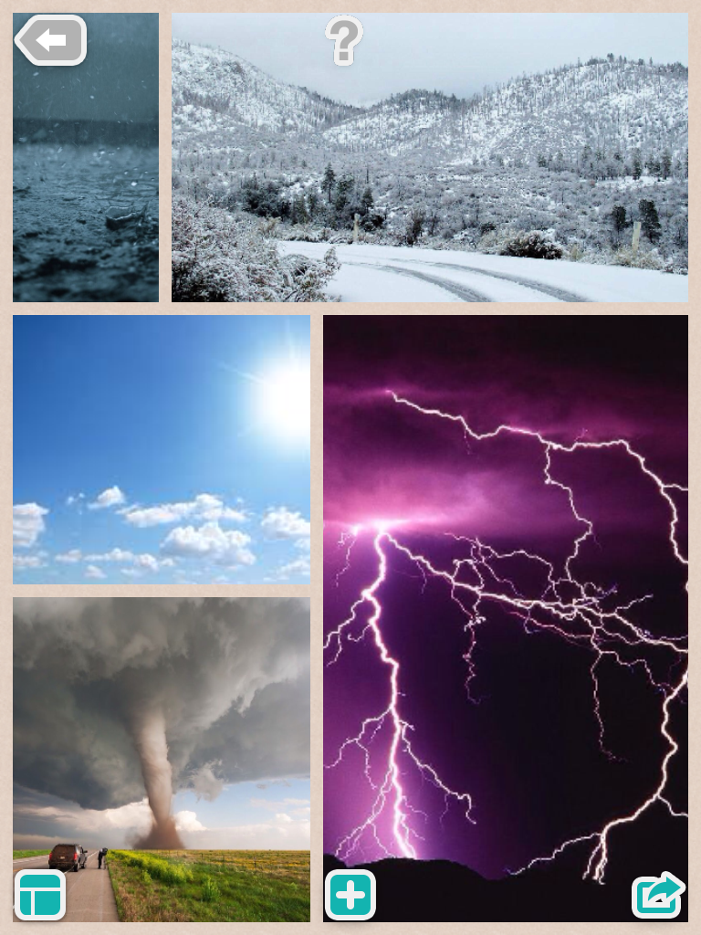
Weather Webpage Project

Slide 2
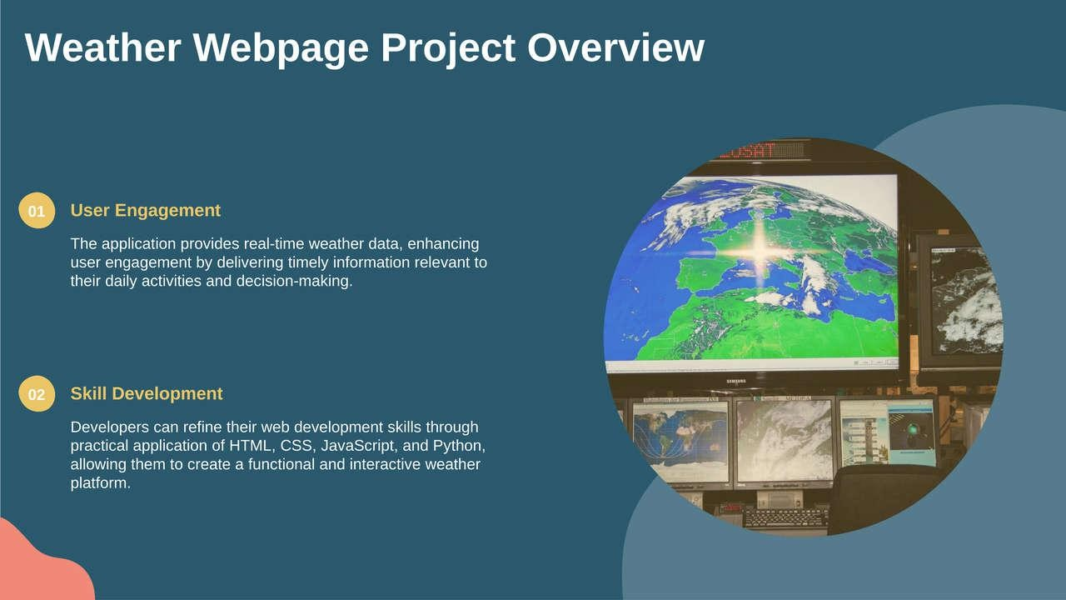

Slide 3
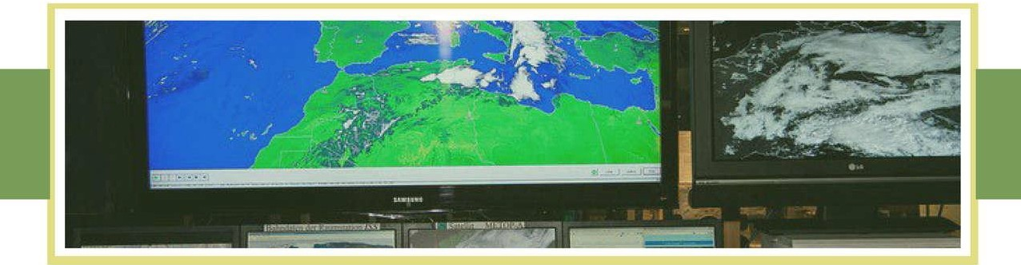



Introduction to Weather Webpage Project
Travel Planning
Event Preparation
Agricultural Management
Users can easily check weather updates to plan their travel itineraries, ensuring a safe and enjoyable experience throughout their journey.
Organizers can utilize the webpage to assess weather conditions, optimizing scheduling for outdoor events and activities, thereby increasing attendance and satisfaction.
Farmers can access real-time weather data lo make informed decisions regarding planting, harvesting, and protecting crops from adverse weather conditions.

Slide 4
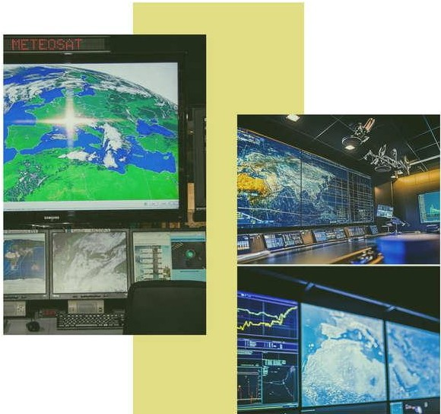
Importance of Real-Time Weather Data
Travel Planning
Accurate weather data enables informed travel decisions and safety.
Event Scheduling
Helps in choosing ideal dates for outdoor events and activities.
Agricultural Decisions
Farmers depend on timely weather updates for crop planning and harvesting.
Disaster Management
Real-time alerts facilitate timely response to severe weather incidents.
Personal Safety
Informs individuals to take precautions during adverse weather conditions.

Slide 5
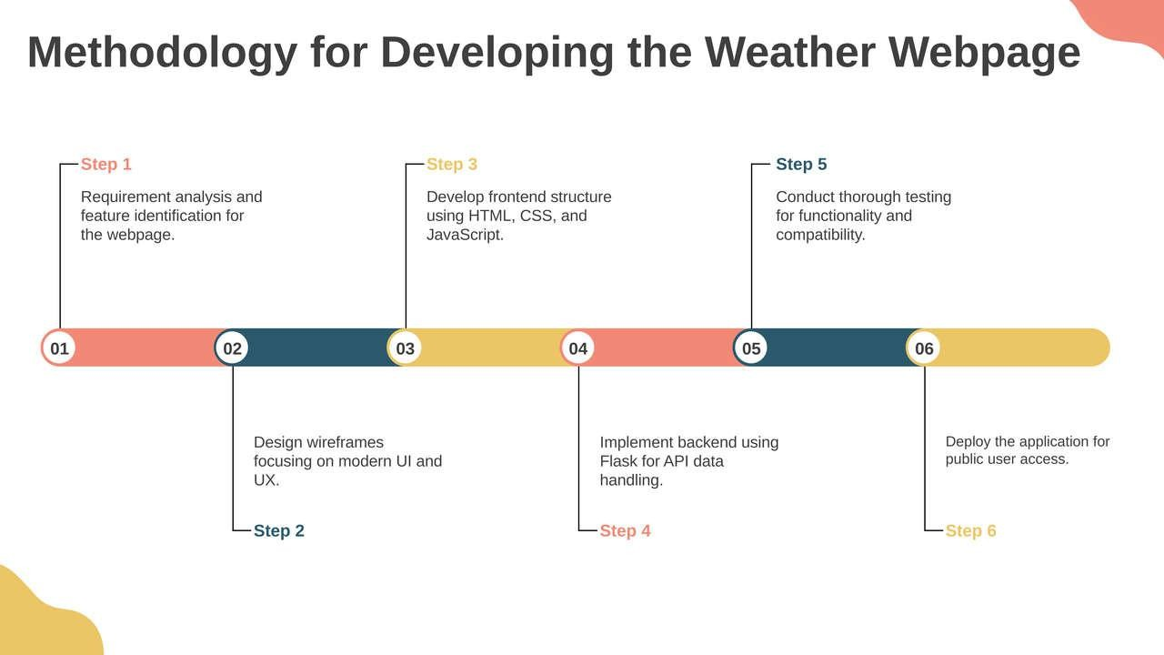

Slide 6
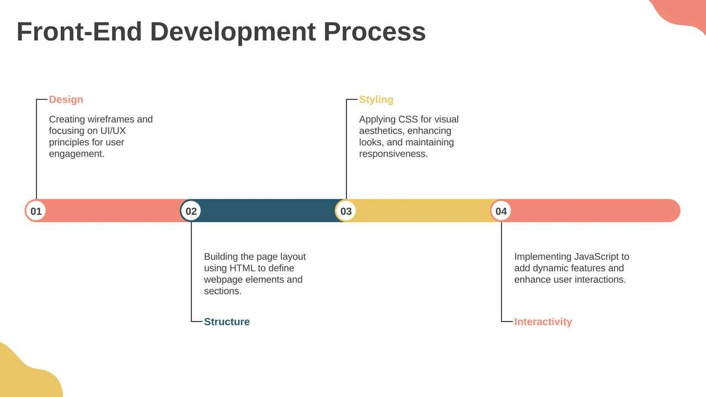

Slide 7
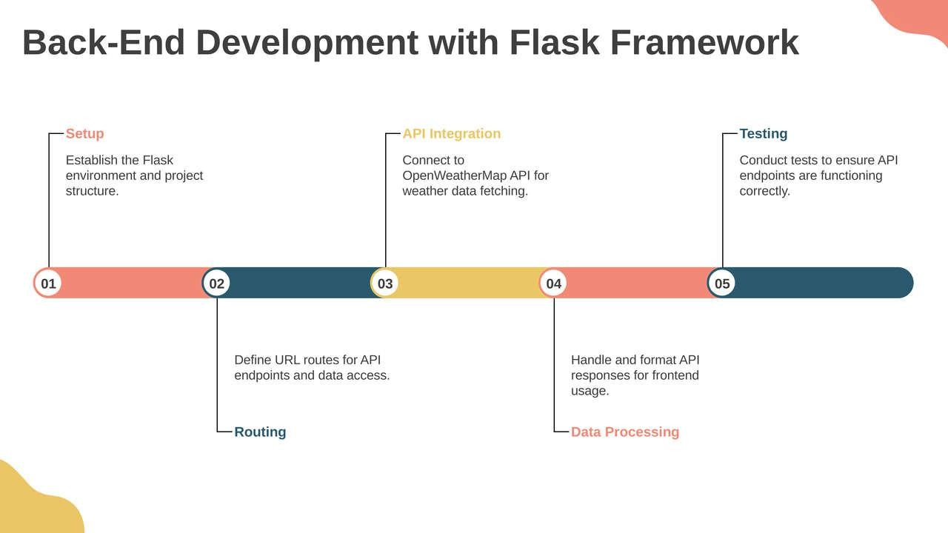

Slide 8
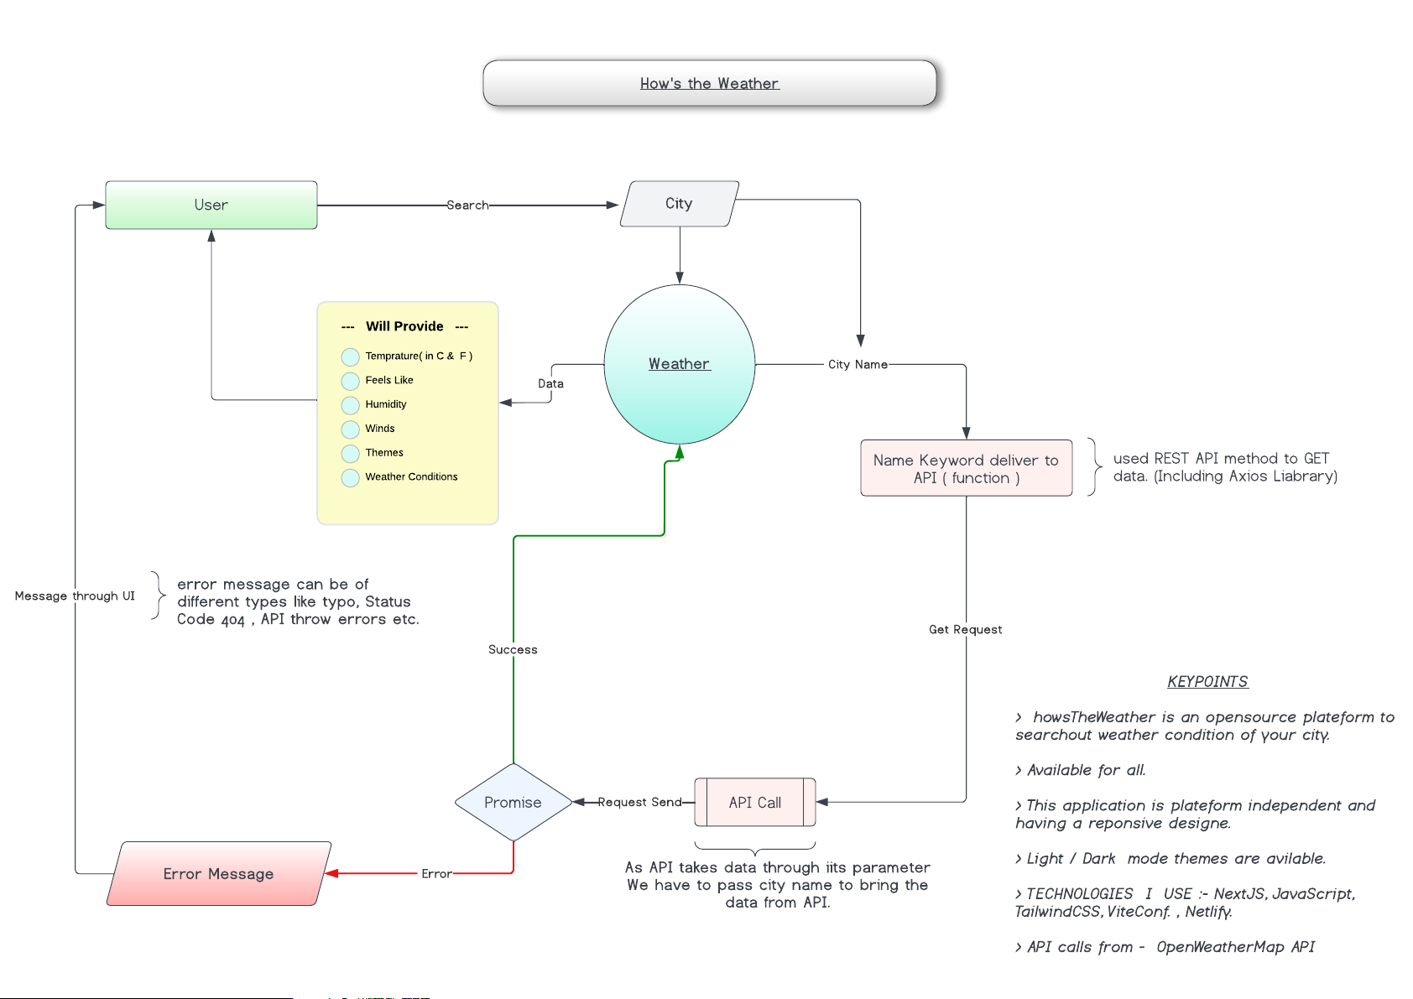
DETAILED WORKING PROCEDURE OF CODE

Slide 9

System Requirements
Hardware /Software | Hardware /Software Elements | Specification/Version
Hardware | Processor | Intel i3/i5/i7 or AMD
 | RAM | Min 4GB
 | HDD/SSD | Min 250 GB
Software | OS | Windows/ Linux/ Mac OS
Connectivity | Wi-Fi | Atleast 1 MBPS

Slide 10


Skill Development in Web Technologies
Web Development API Integration Data Visualization
Enhance skills in HTML, CSS, and JavaScript through hands-on projects,
Learn to effectively connect and utilize OpenWeotherMop API for data fetching.
Implement charts and graphics for better weather data representation.
Responsive Design
Create layouts that adopt seamlessly across different screen sizes.
Error Handling
Develop robust error messaging systems to improve user interactions.
Dynamic Functionality
Use JavaScript to enable real-time updates and interactive features.
Version Control
Practice using Git for code management and collaboration on projects.

Slide 11
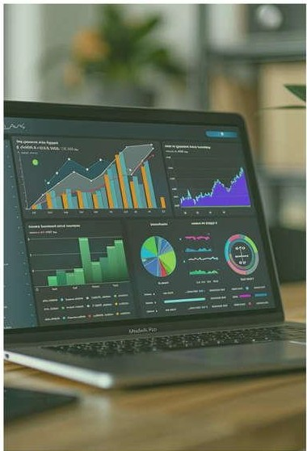
Data Visualization Techniques for Weather Data
Line Charts
Weather Icons
Visualize temperature changes over time using line charts for clarity.
Use icons to illustrate current weather conditions for quick user recognition.
Bar Graphs
Heat Maps
Utilize bar graphs for comparing humidity levels between citieseffectively.
Create heat maps for visualizing temperature ranges across regions visually.
Pie Charts
Forecast Graphs
Represent distribution of weather conditions with pie charts for easy referencing.
Display 24-hour and 5-day forecasts using simple forecast graphs for users.
Interactive Maps
Animated Visualizations
Incorporate maps to show weather patterns globally in an engaging manner.
Implement animations to represent changes in weather data dynamically.

Slide 12




Potential Enhancements for Future Versions
User Notifications
Mobile Compatibility
Implement personalized notifications for severe weather alerts.
Develop a mobile application version for on-the-go access.
Multi-Language Support
Historical Data
Add language optionsto increase accessibility for global users.
Include functionality to view past weather data trends.
&
H• 1 lOI
I design and develop experiences that make people's lives simple.

Slide 13
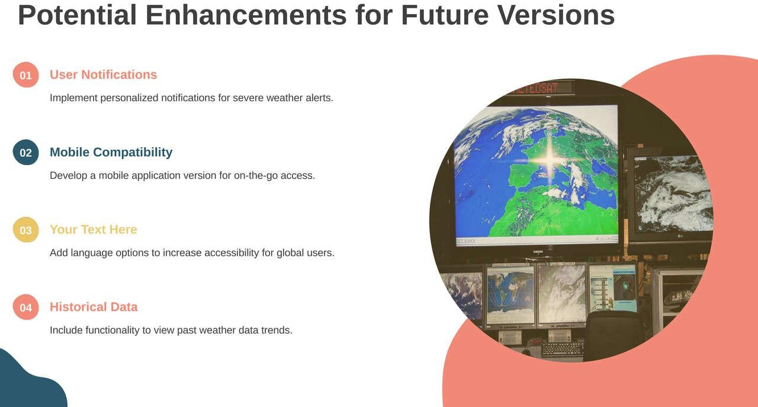

Slide 14
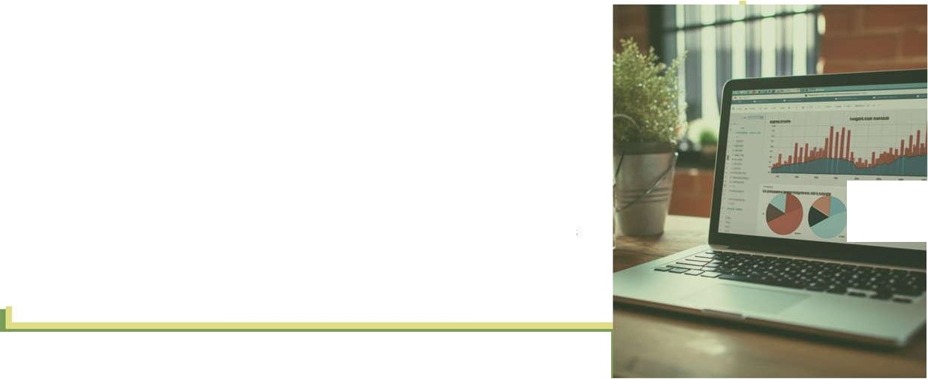
Summary of Project Goals and Achievements
User-Friendly Interface
Real-Time Data Integration
01
02
Designed a responsive platform for seamless navigation and accessibility.
Utilized OpenWeotherMop API for accurate and live weather updates globally.
Enhanced User Experience
Text Here
---- -
03
04
---
- --
Focused on modem UI/UX principles for improved interaction and engagement.
Provided practical learning experience in web technologies and application development.
.
--·---

Slide 15


THANK YOU
Do you have any questions?

